Slide 1
Portishead Medical Group Patient Information Evening
20/2/17

Slide 2
Eye Health and Common Conditions
Anna Neary
Max Howes
Gerwyn Owen
Mary Adams (North Somerset CCG)

Slide 3
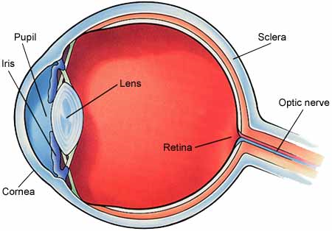
Cataracts

Slide 4
Cataracts
Lens becomes cloudy so vision affected
Nuclear; subcapsular; cortical
1/3 of people over 65yrs old
70% people 85yrs and above
Men and women equally affected
Increased chance if poor diet, smoking, Diabetes, steroid treatment, family history of cataracts, alcohol excess, obesity, previous eye surgery

Slide 5
Cataracts
Symptoms include worsening vision, glare, spots in the vision, colour vision washed out or faded
If concern get eye check via the opticians
Surgery is main treatment but vision has to be worse than 6/12 with correction to offer it on Snellen charts

Slide 6
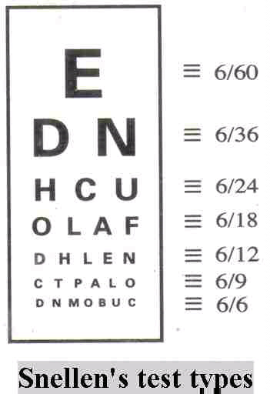
Cataracts

Slide 7
Cataracts
Non surgery-reduce glare, spectacles, tints, smoking cessation, review 4-12months to see if worsening
Surgery-day case
Phacoemulsification and lens implant to replace lens
Steroid eye drops for 4 weeks
Regular review as will need glasses for reading

Slide 8
Age Related Macular Degeneration
Commonest cause of sight impairment in over 50s
Gradual loss of central vision needed for detailed work and for reading and driving.
Can be both rapid or gradual
2 types: wet or dry. Wet most severe
5/100 people over 65 and 1/8 people over 80
Twice as many women over 75 than men

Slide 9
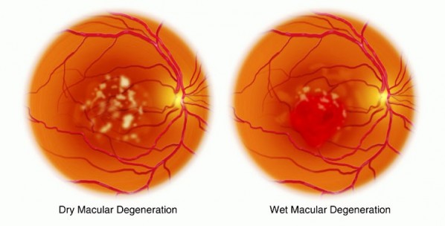
Age Related Macular Degeneration

Slide 10
Age Related Macular Degeneration
Dry in 9/10 cases
Wet 1/10 cases also known as neovascular or exudative
Risk factors include smoking, high blood pressure, family history, sunlight, obesity, poor diet
Visual loss or distortion, greater difficulty reading
Consult optician if worried.

Slide 11
Age Related Macular Degeneration
Dry usually managed in the community and try to reduce risk factors and increase anti oxidants in the diet including vitamins C, E and beta carotene. I Caps night be recommended
Wet- anti VEGF treatment by injection into the globe of the eye. This is repeated 4 weekly and the aim is to reduce new blood vessels. Improves vision in 1/3 people but in most people vision is maintained.

Slide 12
Age Related Macular Degeneration
Severely sight impaired: 3/60
Partially sighted: 6/60
Registered as such by the specialist
Low vision clinics

Slide 13
Questions

