Slide 1
Diet and Cardiovascular Disease
Dr Max Howes
Salaried GP, Portishead Medical Group

Slide 2
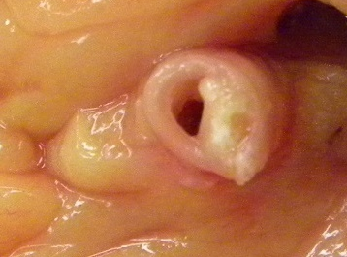
Cardiovascular disease
Diseases of the heart or blood vessels
Build-up of atheroma inside arteries
Modifiable risk factors: Fixed risk factors:
Diet
Blood pressure
Smoking
Physical inactivity
Excess weight
Alcohol
Cholesterol
Triglycerides
Diabetes
Kidney disease
Age
Gender
Family history (genetics)
Ethnicity

Slide 3
Salt (sodium chloride)
Intake should be <5g/day (UK average 9g/day)

Slide 4
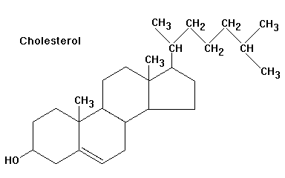
Cholesterol
Necessary – used in cell membranes, but excess is laid down in fatty plaques (atheroma)
Largely made in our bodies by our liver
LDL is ‘bad cholesterol’, HDL is ‘good cholesterol’, triglycerides are globules of circulating fat
Aim for TC <5, LDL <3 – though stricter targets apply in e.g. diabetics (4 and 2 respectively)
How to reduce cholesterol
Lose weight (losing 6 kg could cut LDL by nearly 10%)
Eat a Mediterranean-style diet
Grill, don’t fry, cut visible fat off meat, stop cakes, biscuits, pastries and chocolates
Plant sterols (e.g. Flora Pro-Activ®) or stanols (Benecol®) could lower cholesterol by almost 10%
Exercise regularly
Soluble fibre (oats, legumes, wholegrains, high fibre fruits)

Slide 5
Saturated vs. unsaturated fats
Is saturated fat really as bad as was originally thought?
Association of Dietary, Circulating, and Supplement Fatty Acids With Coronary Risk: A Systematic Review and Meta-analysis Rajiv Chowdhury, MD et al. Ann Intern Med. 2014;160(6):398-406
A major review, 72 studies, over 650,000 people
Compared populations with high and low saturated and unsaturated fat intake
Suggested high intake of saturated fat does not increase the risk to your heart health and eating more polyunsaturated fat doesn't lower it
Association is not causation

Slide 6
Alcohol
Recommendation <14u/week, spread out, with two days off
1-2u/day proven to reduce the risk of CHD
Positive effect on HDL/LDL ratio and clotting
Higher levels of consumption increase risks from other causes – excess alcohol leads to weight gain, hypertension, damages heart muscle

Slide 7
Superfoods, super-fads
Can you correct the ills in your life by eating goji berries?
Everyone’s looking for an easy fix (and quacks are looking for something easily marketable)
There’s no big secret, it’s in fact very simple (and so hard to sell) - eat a balanced, varied and modest diet
‘Superfoods’ give the impression that ordinary, affordable everyday foods are somehow deficient
Rather than spending £5 on algae and bean sprouts in Waitrose, a family would be better off buying regular and larger quantities of fresh fruit and veg from their local market

Slide 8
Mediterranean diet
Proven to reduce cardiovascular disease, also diabetes, obesity, some cancers, Parkinson's and Alzheimer's disease
Principles:
Maximise vegetables, legumes, fruits and wholegrain cereals
Limit red meat – chicken, lentils, beans, chickpeas
Eat more fish
Use olive oil/rapeseed oil in place of animal fat
Limit processed foods/ready meals
Eat no more than moderate amounts of dairy products (low fat)
Do not add salt
Snack on fruit, dried fruit and unsalted nuts
Drink red wine during meals, but no more than two small glasses per day
Water is the healthiest soft drink

Slide 9
Further reading
https://www.bhf.org.uk/heart-matters/healthy-eating-toolkit/recipe-finder

