Slide 1
Sun & Skin
Dr Robin Pullen

Slide 2
UV light from the sun or sunbeds
Infrared rays- causes the heat that we feel. This does not damage the skin.
UVA- causes sunburn (you cannot feel it- hence burning on cool days). This is the main cause of cancer.
UVB- ages the skin and penetrates deeply. Much less likely to cause sunburn and hence cancer.
Getting sunburnt just once every 2 years can triple your risk of melanoma.

Slide 3
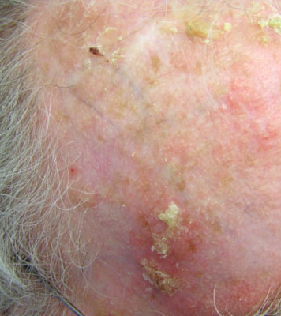
Sun Damaged Skin
Actinic (Solar) Keratosis
Crusty scaly growth caused by UV damage. Think old mans bald scalp
Considered pre-cancerous but risk is probably low
Can be simply managed with moisturiser if not problematic
Treatment options include Liquid Nitrogen and various creams that cause a chemical burn to the skin.

Slide 4
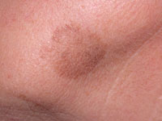
Sun Damaged Skin
Lentigo-
Pigmented flat or slightly raised lesion with a clearly defined edge
Caused by UV radiation – sunburn or sunbeds
Sometimes caused a liver spot.

Slide 5
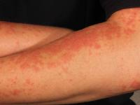
Allergic Reaction to Sun Exposure
Polymorphic Light Reaction
Immune response to spring/summer UV exposure
Common in young women 20-40 years old
Milder versions seen in up to 20% Northern Europeans
Lots of variations seen such as Juvenile light reaction

Slide 6
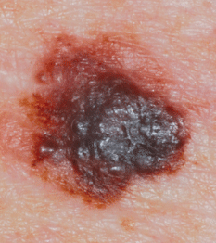
Skin Cancer
Malignant Melanoma
These are almost exclusively enlarging black/brown lesions
Checklist to consider
Changing shape (>7mm)
Irregular shape
Irregular colour
Inflammation
Oozing
Change in sensation- itch
Compare to other skin lesions-looking for a Black Swan or the odd-one-out
Nodularity (raised/lumpy) is more worrying

Slide 7
Skin Cancer
Malignant melanoma
Self-photos- have to be very good to be useful-
(in rashes they can be very useful)
Not just about cumulative exposure to sunlight
Thought to be related to burning especially as a child
Early presentation has a big impact on rates of cure

Slide 8
Skin Cancer (non-melanoma)
Related to cumulative sun exposure- often on sun exposed sites- head, neck, ears, arms, hands and lower legs

Slide 9
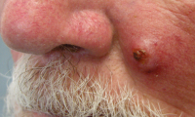
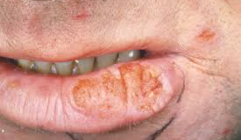
Skin Cancer (non-melanoma)
Squamous cell carcinoma
Enlarging scaly or crusty lumps
Grow weeks to months (relatively fast)
Sometimes tender and may ulcerate
More common in immunocompromised

Slide 10
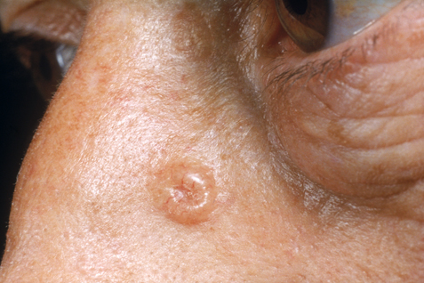
Skin Cancer (non-melanoma)
Basal Cell Carcinoma
Rodent ulcer
Usually ulcerated, raised rolled edge
Common to head and neck and upper chest
Slow growing
Do not spread
Routine referral

Slide 11
Skin Damage- Prevention
Safe sun expose is healthy and promotes wellbeing and builds up supplies of vitamin D
Avoid burning especially as a child
Avoidance of midday sun and the use of shade, sun hats and sunglasses is better than any lotion or cream
Hair is a brilliant sun guard. If you have little.. wear a hat!
Immunocompromised at higher risk of SCC
https://www.youtube.com/watch?v=HtOWkWV49QA

